Slide 1
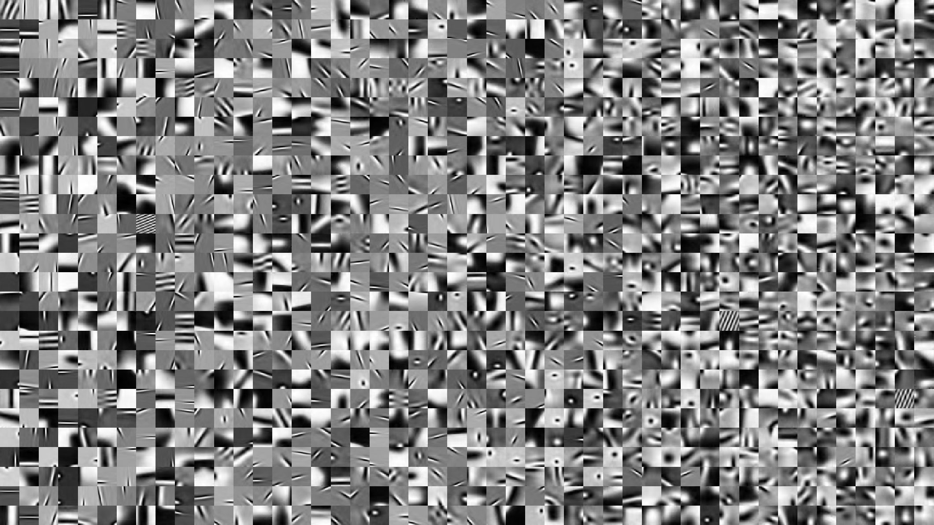
Sparse and Redundant Representations and Their Applications in
Signal and Image Processing (236862)
Section 2: Uncertainty & Uniqueness of Sparse Solutions
Winter Semester, 2018/2019
Michael (Miki) Elad

Slide 2
Meeting Plan
Quick review of the material covered
Addressing issues raised by other learners
Answering questions from the students and getting their feedback
Discussing a new material
Administrative issues

Slide 3
Overview of the Material
Theoretical Analysis of the Two-Ortho Case
The Two-Ortho Case
An Uncertainty Principle
From Uncertainty to Uniqueness
Theoretical Analysis of the General Case
Introducing the Spark
Uniqueness for the General Case via the Spark
Uniqueness via the Mutual-Coherence
Spark-Coherence Relation: A Proof
Uniqueness via the Babel-Function
Upper-Bounding the Spark
Demo - Upper Bounding the Spark
Constructing Grassmanian Matrices
Demo - Constructing Grassmanian Matrices

Slide 4
Issues Raised by Other Learners
What is the mutual-coherence of a unitary matrix?
What is the Spark of the [I,F] (two-ortho) matrix?
What is the mutual-coherence of [I,W], where W is an orthogonal wavelet (say Haar)?

Slide 5
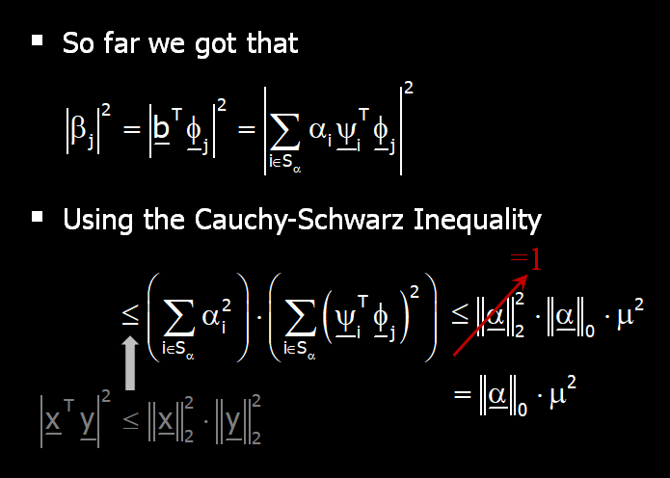
Issues Raised by Other Learners
Proof of the uncertainty law #1 (slide 18 of section 2)
I could not understand the application of the Cauchy-Schwarz inequality to proof the uncertainty law #1 (slide 19 of section 2). Who are the vectors x and y in this case ?

Slide 6
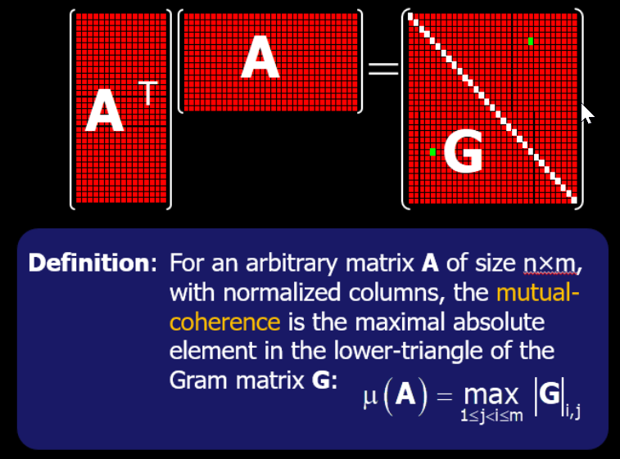
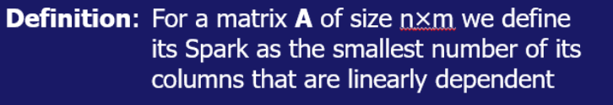
Issues Raised by Other Learners
The proof about the connection between the Spark and the mutual coherence – Let’s go through it again

Slide 7
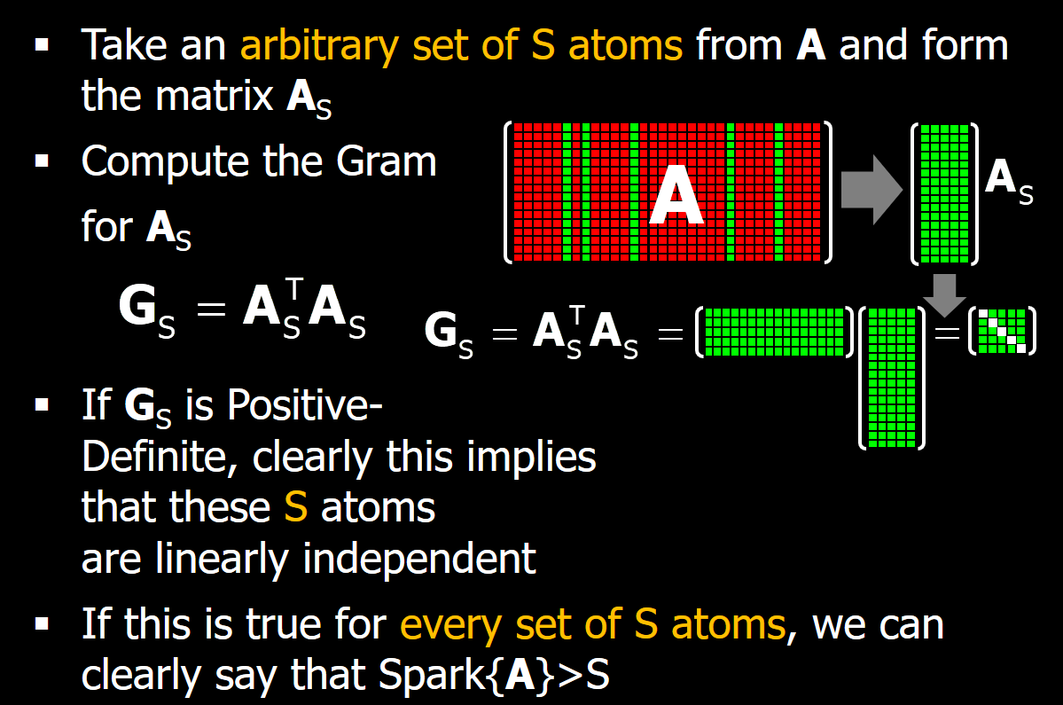
Issues Raised by Other Learners

Slide 8
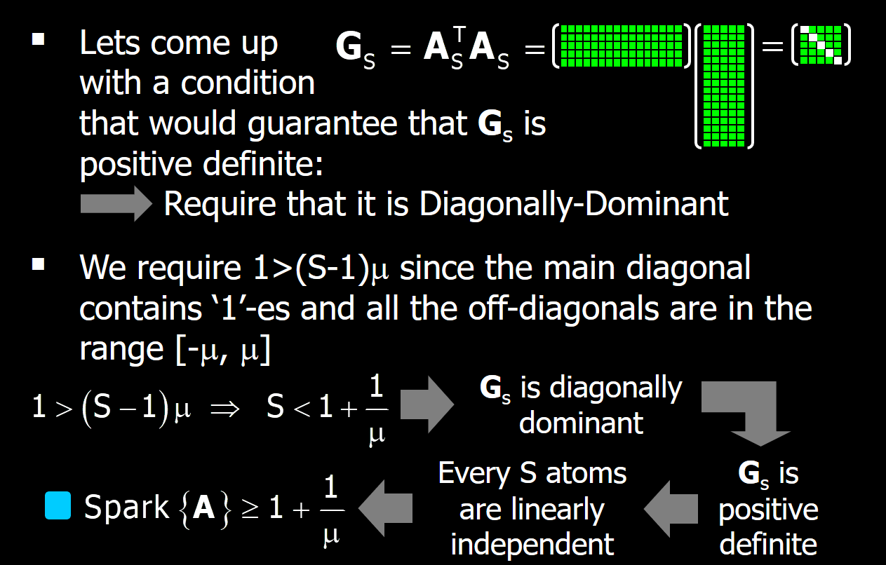
Issues Raised by Other Learners

Slide 9

Your Questions and Feedback

Slide 10
New Material?
Why are we bothering with the Two-Ortho case?
It leads to elegant analysis (e.g., uncertainty theorems)
It eases the time-frequency tension (many transforms tried to gain both worlds, Wavelet included)
It provides an intuitive explanation of the notion of sparse representation – lack of sparsity in each domain, and yet very sparse when both are used
And … mostly for historical reasons

Slide 11
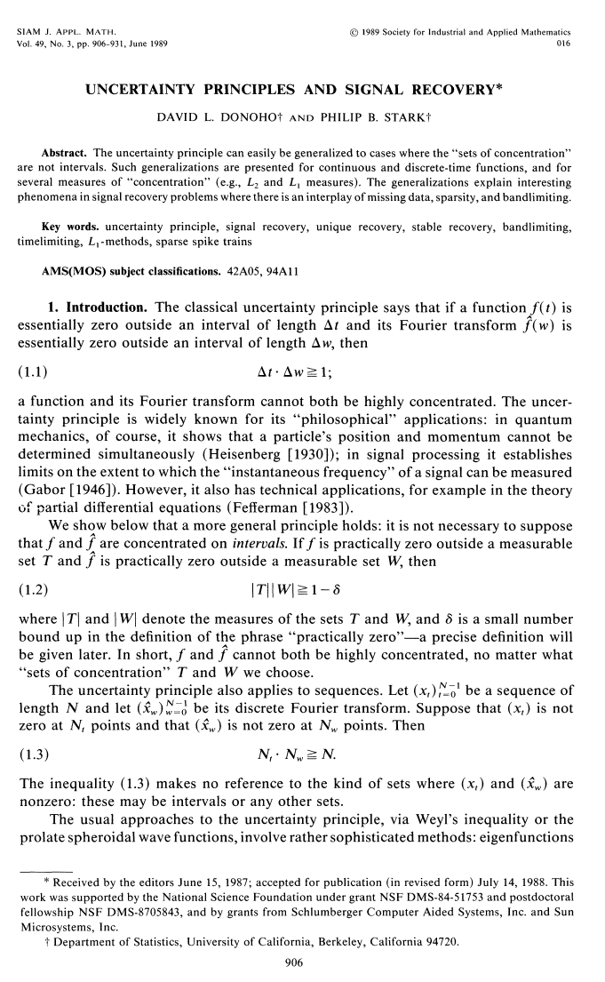
New Material?
It all started with this seminal paper that brought the first uncertainty principle for the Identify-Fourier ortho-representations

Slide 12
New Material?
What's in it?
The uncertainty rule we saw for the Identity-Fourier case: N_{t} ⋅ N_{w} ≥ N or N_{t} + N_{w} ≥ 2√N
A similar result for the continuum
Generalizations of the above uncertainties to L₁ and other norms
Reconstruction of a signal from partial Fourier data – early signs of Compressed-Sensing (CS)?
Relevant to our stage of the course

Slide 13
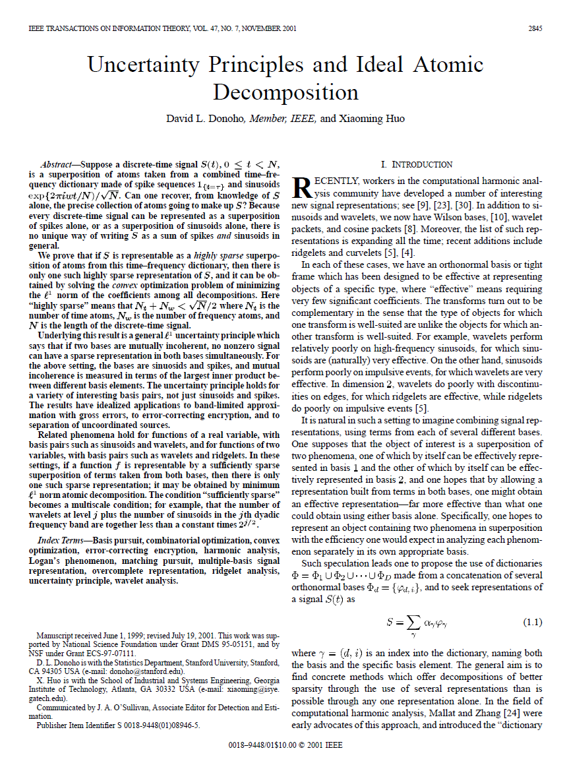
New Material?
More than a decade later, Donoho revisited this topic, generalized it to arbitrary two-ortho bases, and augmented it with the “L₁ story”, which we will cover later on in the couse

Slide 14
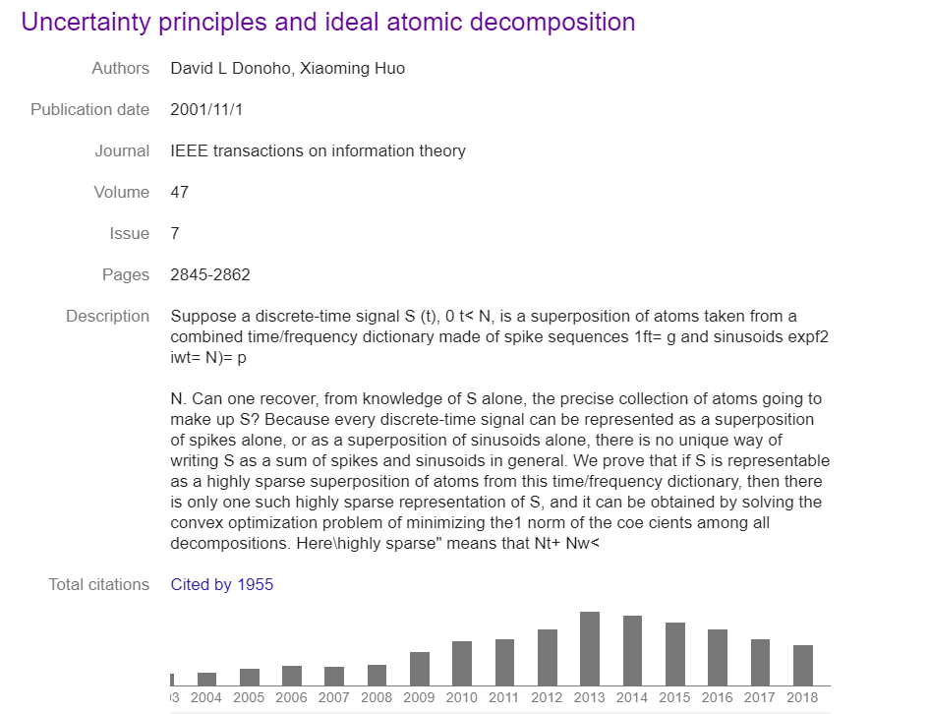
New Material?
Look at the impact of this paper

Slide 15
New Material?
What's in it?
Definition of P₀ and uniqueness of its solution for the [I,F]
Generalizing the uncertainty to any pair of ortho-bases by defining μ: N_{Ψ} + N_{Φ} ≥ 1+1/μ
Showing that P₁ could sometimes lead to the solution of P₀
Proving uniqueness of the P₁ solution
Considering multi-scale bases
Considering random ortho-bases

Slide 16
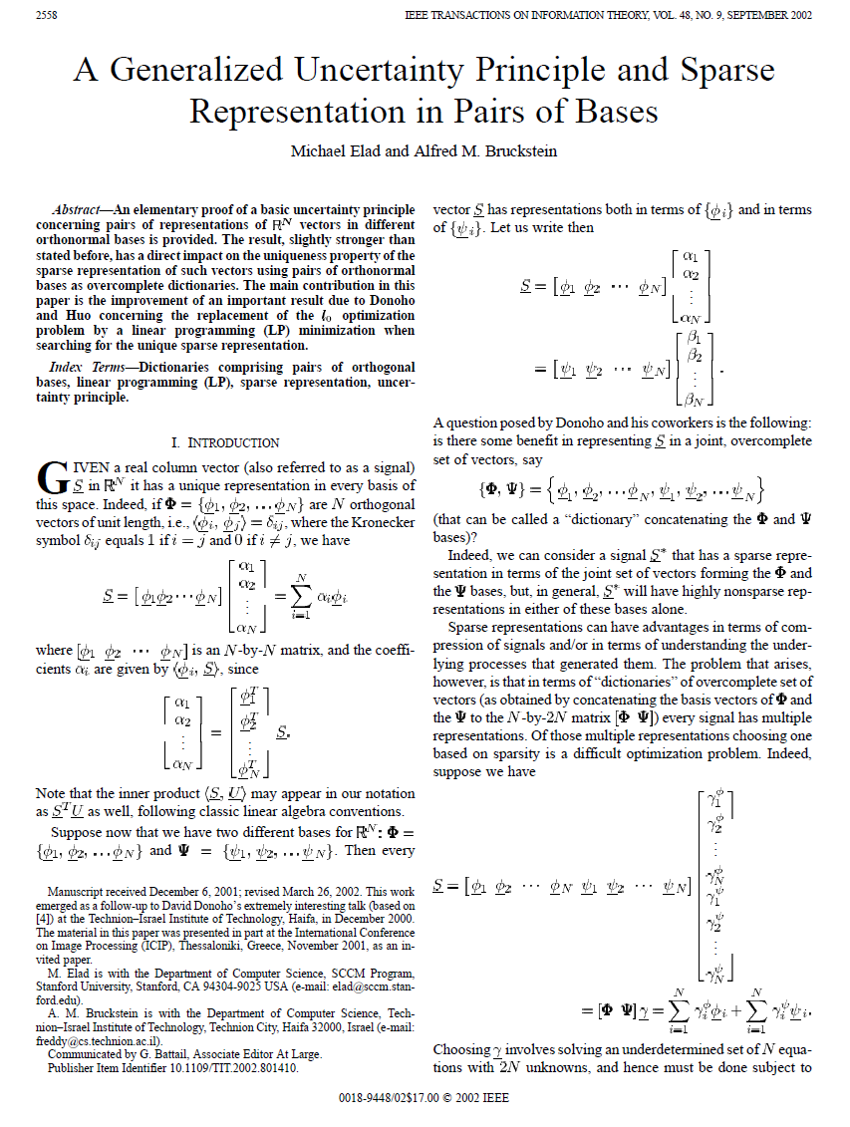
New Material?
One of the immediate follow-up papers is this one … which improved both the uncertainty and the L₁ guarantee bounds

Slide 17
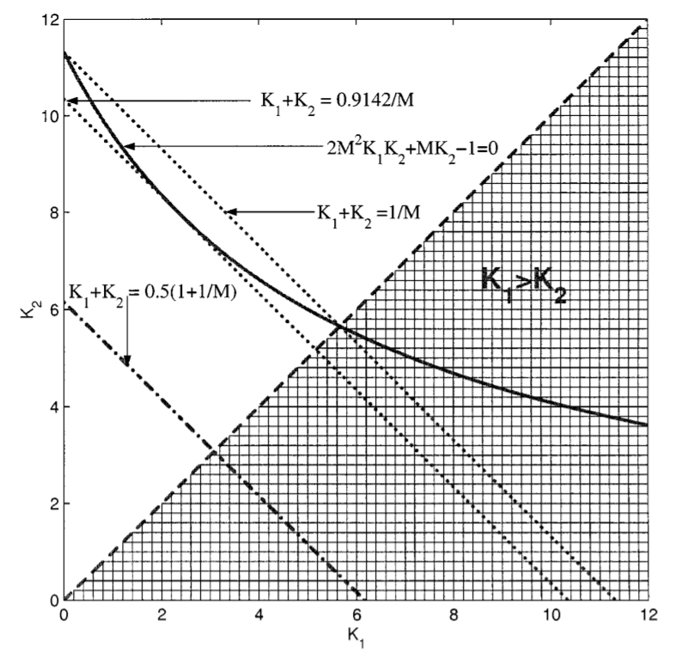
New Material?
What's in it?
Improving the uncertainty rule for general pairs of ortho-bases to: N_{Ψ} + N_{Φ} ≥ 2/μ
Strengthening the result for using P₁ as a solver for P₀

Slide 18
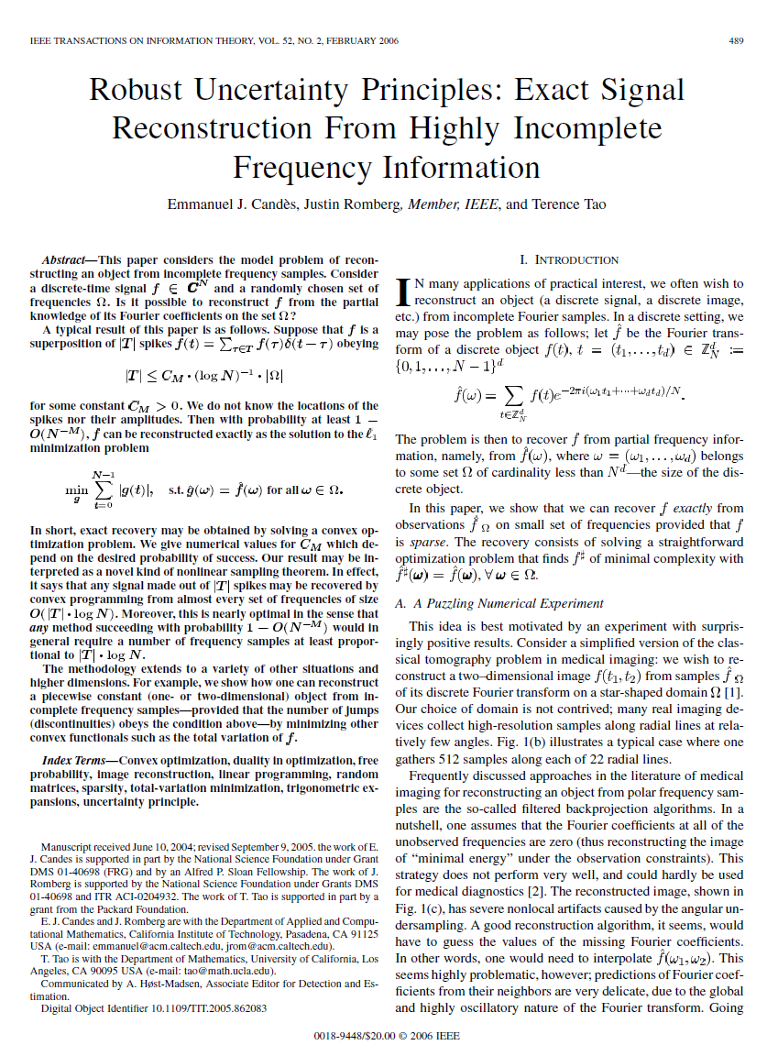
New Material?
And after few more years, we got to this follow-up work by Candes, Romberg and Tao, which generalized the uncertainty rule to a probabilistic language, and introduced the concept of Compressed-Sensing
[see Eq. (1.10) & (1.11)]

Slide 19
New Material?
What's in it?
Generalizing the uncertainty rule for [I,F] to a probabilistic language: With high probability we get N_{t} + N_{w} ≥ c⋅N/√logN [instead of N_{t} + N_{w} ≥ 2√N]
The main contribution of this paper is proving that there is a practical ability of recovering a sparse signal from partial Fourier measurements (CS) – the paper sets clear conditions for this to be true
A generalization of the above to piece-wise constant signals

Slide 20
Administrative Issues

Slide 21
